Slide 1
SQA

Slide 2
Quality Concepts
Variation Control
Quality
Quality of Design
Grade of materials tolerances performance specs
Focuses on Requirements, Spec and Design
Quality of Conformance
Degree to which design specs are followed
Focuses on Implementation
Resources
Staff Equipment
Time
Minimization of Bugs
Speed and Accuracy

Slide 3
Quality Control and Quality Assurance
Quality Control
Inspections
Reviews
Tests
Feedback - to minimize the defects produced
Can be Automated, Manual or a combination of Automated tools and human Interaction
Key concept - all work products have defined, measurable specifications which will be compared with the output of each process.
Quality Assurance
Auditing
Reporting functions
To provide data to mgmt about Product quality
Mgmt identifies problems and address them
Key concept - to provide management with the data necessary to be informed about product quality, thereby gaining insight and confidence that product quality is meeting its goals

Slide 4
Cost of Quality Includes all costs incurred in the pursuit of quality or in performing quality-related activities. Cost of quality studies are conducted to provide a base- line for the current cost of quality, identify opportunities for reducing the cost of quality, and provide a normalized basis of comparison.
Prevention Costs
Quality planning
Appraisal Costs
In-process and inter-process inspection
Failure Costs
Internal Failure
External Failure
Formal technical reviews
Training
Equipment calibration and maintenance
Testing
rework
repair
failure mode analysis
complaint resolution
product return and replacement
help line support
warranty work
Test equipment

Slide 5
SQA Activities
SQA
Software Engineers
Development
SQA Group
Quality assurance planning
Oversight
Record keeping
Analysis and Reporting

Slide 6
SQA activities recommended by Software Engineering Institute – Assignment 8
Prepares an SQA plan
Fill in the box
Participates in the development of the project’s software process description.
Fill in the box
Reviews software engineering activities to verify compliance with the defined software process.
Fill in the box
Audits to verify compliance with those defined as part of the software process.
Ensures that deviations are documented and handled
Records any noncompliance and reports to senior management
Fill in the box
Fill in the box.
Fill in the box

Slide 7
Elements of SQA – Assignment 9
Standards
Fill in the Blanks
Risk Management
Fill in the Blanks
Reviews and Audits
Safety
Security Management
Testing
Vendor Management
Change Management
Defect Collection and Analysis
Fill in the Blanks
Fill in the Blanks
Fill in the Blanks
Fill in the Blanks
Education
Fill in the Blanks
Fill in the Blanks
Fill in the Blanks
Fill in the Blanks

Slide 8
SOFTWARE REVIEWS
Filter for the software engineering process.
Applied at various points during software development and serve to uncover errors and defects that can then be removed.
Purify the software engineering activities that we have called analysis, design, and coding.
Way of using the diversity of a group of people to:
1. Point out needed improvements in the product of a single person or team;
2. Confirm those parts of a product in which improvement is either not desired or not needed;
3. Achieve technical work uniformly, or at least more predictable, quality than can be achieved without reviews, in order to make technical work more manageable.

Slide 9
Review Guidelines – Assignment 10
Review the product, not the producer
Review your early reviews
Set an agenda and maintain
…….
…….
Limit debate
……
…….
……
…..

Slide 10
Statistical SQA
Statistical quality assurance reflects a growing trend throughout industry to become more quantitative about quality.
It implies the following steps:
Information about software errors and defects is collected and categorized
Attempt to trace each error to its underlying cause
Nonconformance to specifications
Design error
Violation of standards
Poor communication with customer
Using Pareto Principle (80 percent of the defects can be traced to 20 percent of all possible causes), isolate the 20 percent (the "vital few").
Once causes are identified

Slide 11
To illustrate this, assume that a software engineering organization collects information on defects for a period of one year. Some of the defects are uncovered as software is being developed.
Although hundreds of different errors are uncovered, all can be tracked to one (or more) of the following causes:
incomplete or erroneous specifications
violation of programming standards
inconsistent component interface
misinterpretation of customer communication
intentional deviation from specifications
error in data representation
incomplete or erroneous testing
inaccurate or incomplete documentation
error in programming language translation of design
ambiguous or inconsistent human/computer interface
miscellaneous

Slide 12
Software Reliability
Software reliability is defined in statistical terms as "the probability of failure-free operation of a computer program in a specified environment for a specified time"
Can be measured directed and estimated using historical and developmental data.

Slide 13
If we consider a computer-based system, a simple measure of reliability is meantime- between-failure (MTBF), where
MTBF = MTTF + MTTR
Software availability is the probability that a program is operating according to requirements at a given point in time and is defined as
Availability = [MTTF/(MTTF + MTTR)]

Slide 14
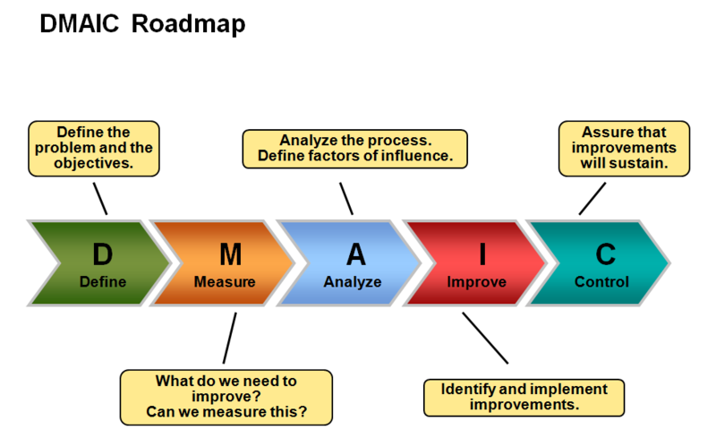
Six Sigma for Software Engineering
If an organization is developing a software process (rather than improving an existing process), the core steps are augmented as follows:
Design the process to (1) avoid the root causes of defects and (2) to meet customer requirements.
Verify that the process model will, in fact, avoid defects and meet customer requirements.
This variation is sometimes called the DMADV (define, measure, analyze, design, and verify) method.

Slide 15
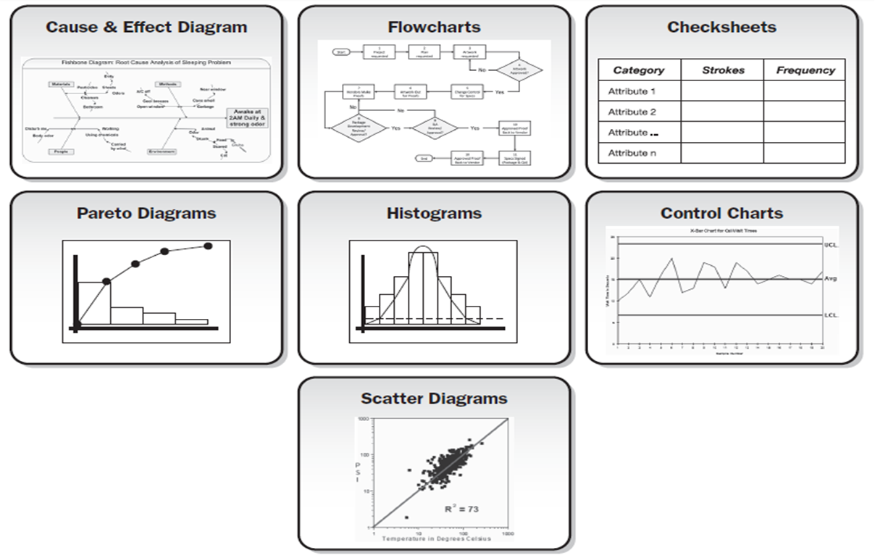
Tools of Quality Control

Slide 16
Pareto Diagram
When to Use a Pareto Chart
When analyzing data about the frequency of problems or causes in a process.
When there are many problems or causes and you want to focus on the most significant.
When analyzing broad causes by looking at their specific components.
When communicating with others about your data.
Left vertical axis is frequency of occurrence
Right vertical axis is the cumulative percentage of the total number of occurrences

Slide 17
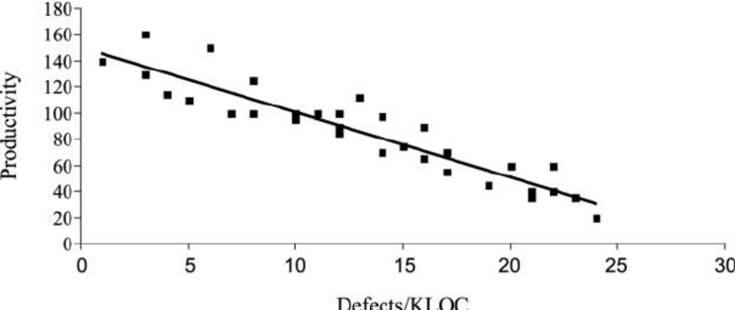
Scatter Diagram
The scatter diagram is drawn with two variables –Independent and Dependent
A scatter diagram is a graph that shows the relationship between two variables. Scatter diagrams can demonstrate a relationship between any element of a process, environment, or activity on one axis and a quality defect on the other axis.

Slide 18
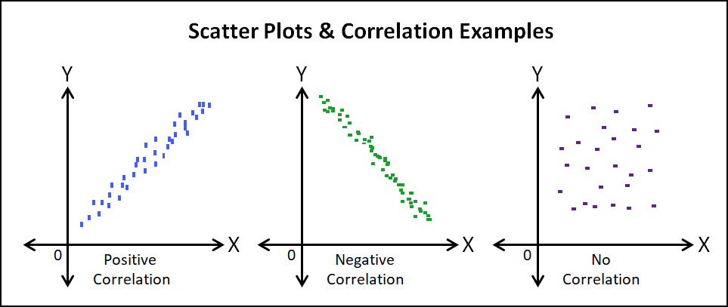
Types of Scatter Diagrams

Slide 19
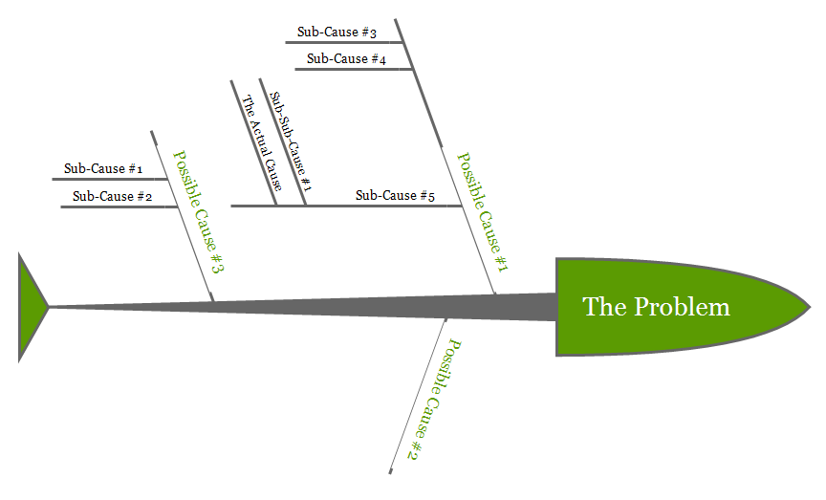
Cause-Effect diagram
These are the best and most common practices when creating cause and effect diagrams.
Identify the problem. Define the process or issue to be examined.
Brainstorm. Discuss all possible causes and group them into categories.
Draw the backbone. Once the topic is identified, draw a straight, horizontal line and on the right side, draw a rectangle at the end which indicates the problem
Add causes and effects. Causes are added with lines branching off from the main backbone at an angle. Write the description of the cause at the end of the branch. The end result should resemble a fish skeleton.
Analyze. Once the diagram has been completed, analyze the information as it has been organized in order to come to a solution and create action items.

Slide 20
